Slide 1
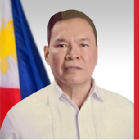
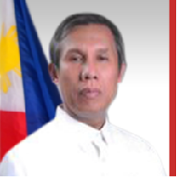
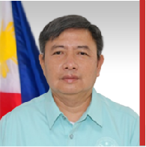
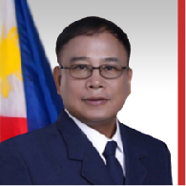
ANSELMO S. AVENIDO JR.
Chairman, Policy Formulation Committee
• BS PMA 1967, Grad # 1, Summa Cum Laude &
Academic Star Awardee
• P/Deputy Director General, PNP
• MPA, UP; MBGA, ADMU; & MMAS, USACGSC
• P/Lieutenant General, PNP (Ret)
• Chairman, Dangerous Drug Board
• Director General, PDEA
• USec, DILG
• DCA & TCDS, PNP
• Chairman, PMAAAI, 2015-2016
• President, PETFI
• Chairman & President, PMAFI
DEMOSTHENES C. DOPLAYNA
Chairman, Membership Committee
• BS PMA 1982 with Academic Board Star
• Master in Business Management, AIM, 1993
• Head, Investment Assistance Department, AFPRSBS 1994-1996
• President, PMA Development Foundation Inc., 2013-2018
• Managing Director, Facilities Managers Inc.
• Chairman & President, Facility Servisys Inc.
• Cavaliers Award, PMAAAI, 2023
FLORENTINO P. MANALASTAS JR.
Chairman, Project Evaluation Committee
• BS PMA 1983
• Master in Business Administration 1988, UP
• Juris Doctor 1994, St. Louis University, BC
• Executive Doctorate in Education Leadership (Lacking Dissertation),
Development Academy of the Philippines
Dean, Corps of Professor, AFP
OIC-Executive Director, ATC-PMC, OP
Corporate Secretary, AFPSLAI
Dangal na Lipi Awardee (Bulacan)
ALLAN O. CORPUZ
Chairman, Ways & Means Committee
• BS PMA 1991
• MBA (Top Executive Program), PLM
• MPM Major in Security & Development, DAP
• PhD in Public Administration, GPTU
• MNSA, NDCP
• Commander, Coast Guard District SEM/Coast Guard Mindanao Area Command
• Secretary General & Corporate Secretary, TFOE-PE, Inc.
• DPDGL/PGLI/PM, GLF&AMP
• Past High Sherif, Balisong Shrine Club
• Most Outstanding Worshipful Master, MD NCR-C for
MY 2022-23

